Slide 1
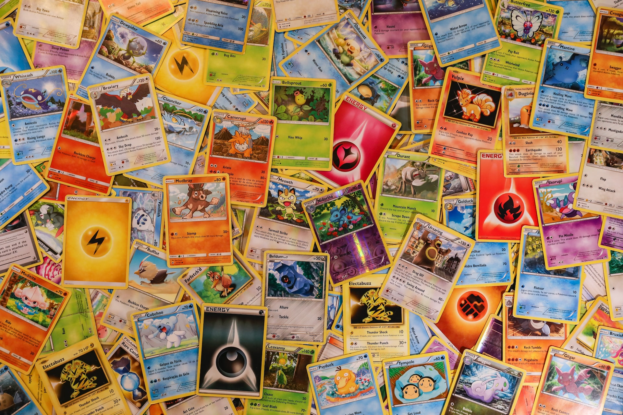
Pokémon Cards
Presentation Template

Slide 2
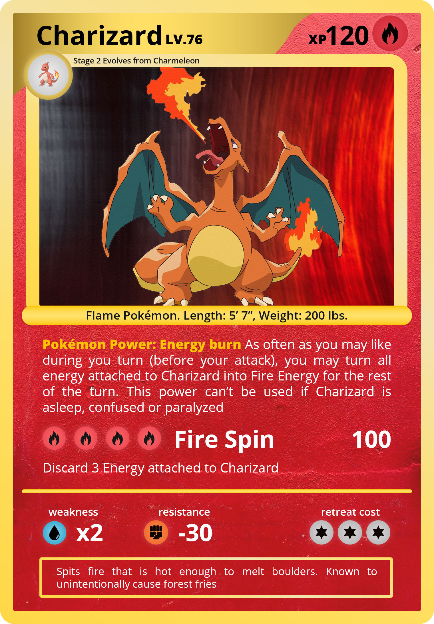
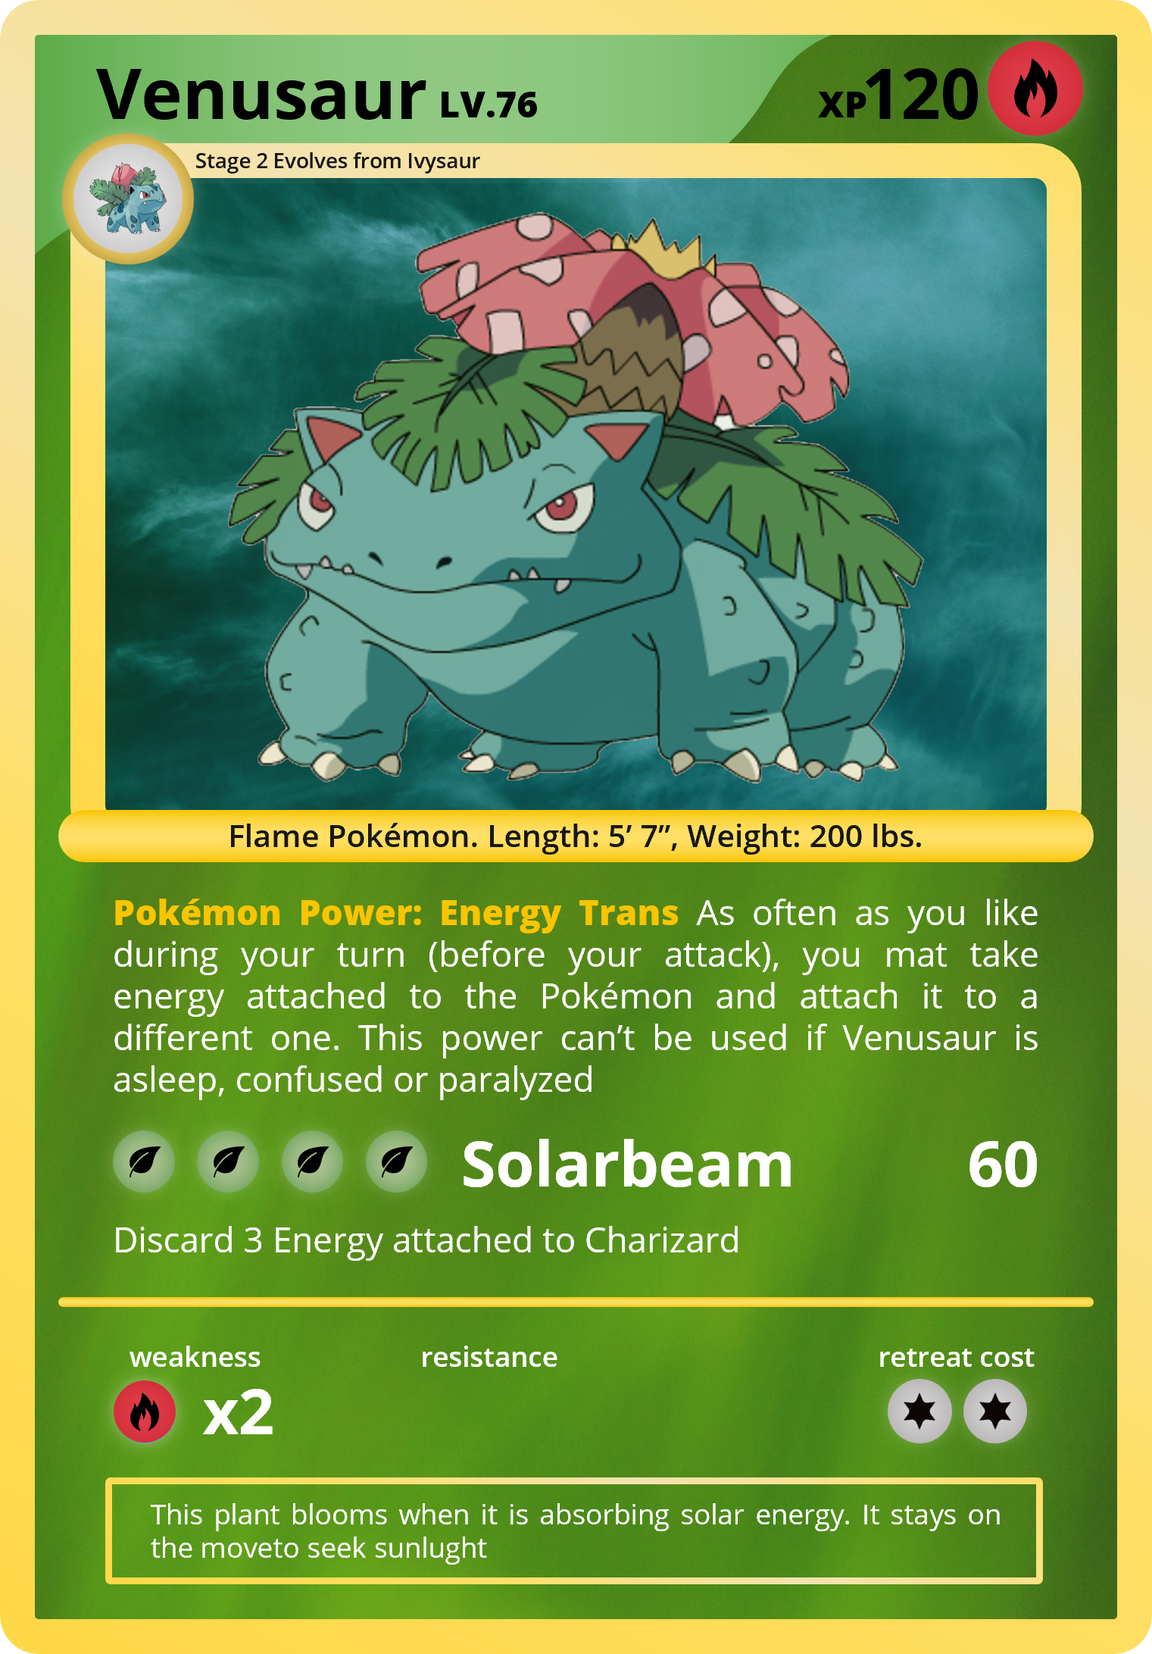
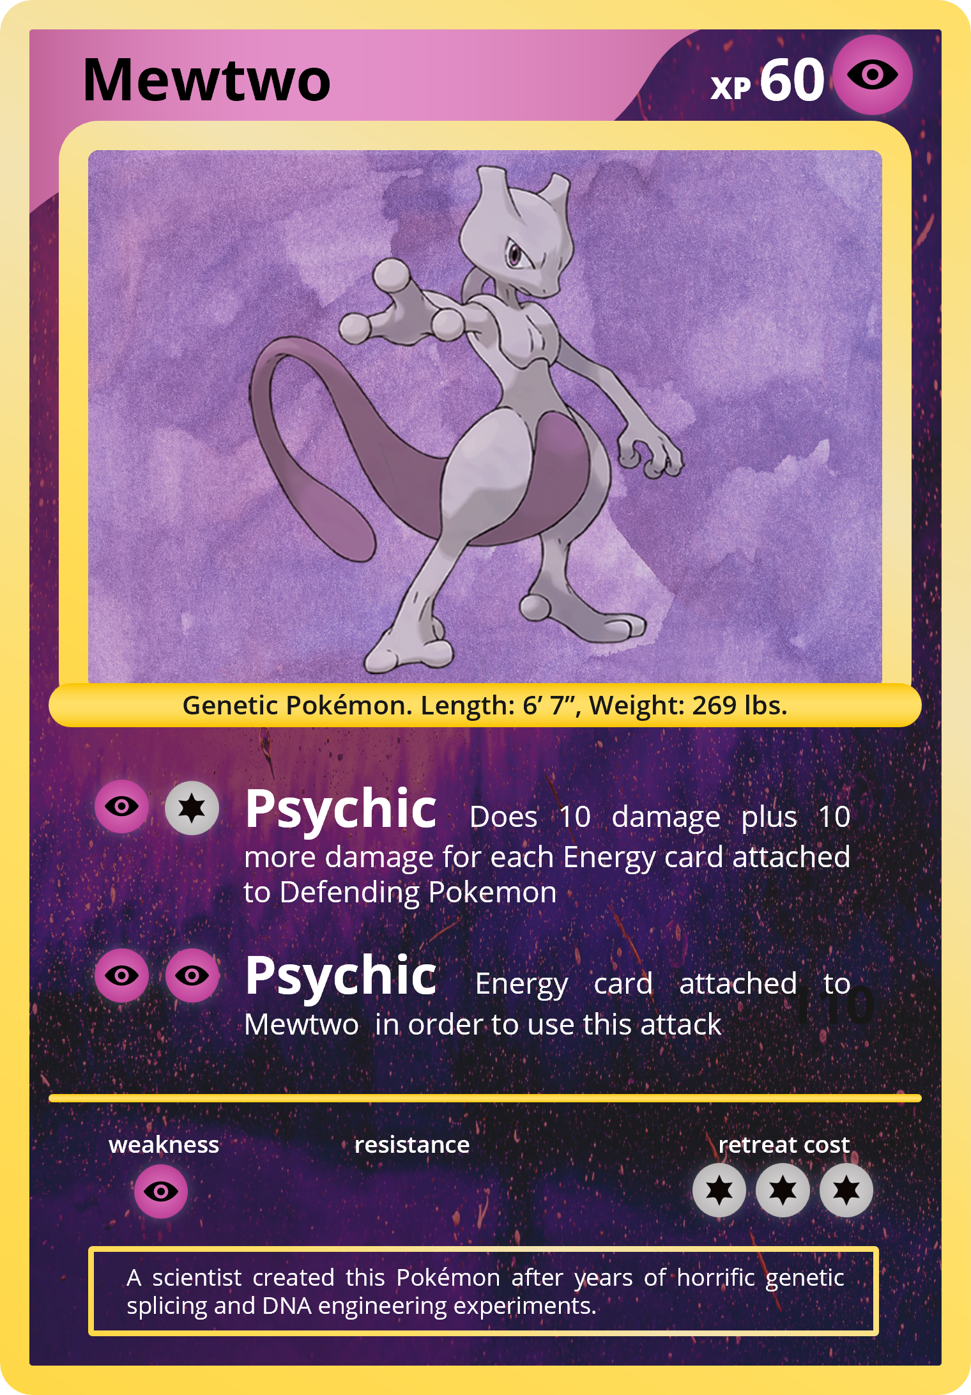
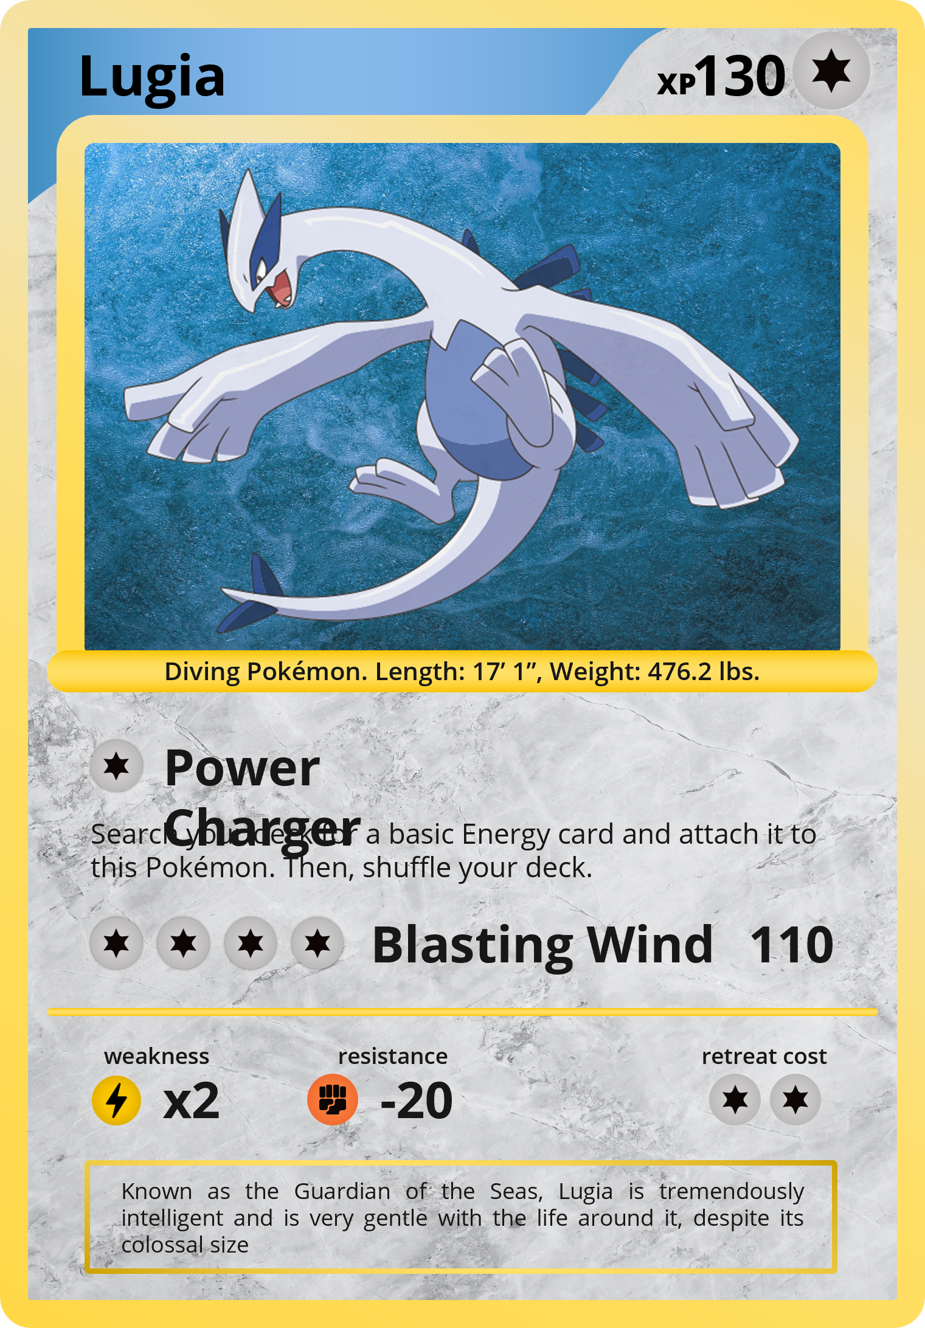
The Pokémon Trading Card Game, abbreviated as PTCG or Pokémon TCG, is a collectible card game based on the Pokémon franchise. It was first published in October 1996 by Media Factory in Japan. In the US, it was first published by Wizards of the Coast. In June 2003, Nintendo transferred the publishing rights from both Media Factory and Wizards of the Coast to The Pokémon Company. As of March 2022, the game has sold over 43.2 billion cards worldwide.

Slide 3
Collecting Pokémon Cards
Collecting Pokémon cards is a fun, interactive hobby for anyone and everyone. These Japanese "pocket monster" cards can be used to play the Pokémon trading card game or you join the people across the world collecting cards to try and "catch 'em all"!

Slide 4
Why Are Pokémon Cards So Expensive?
Pokémon cards are some of the most popular and expensive trading cards available. While there are many reasons for their high prices, the most significant contributing factor is the limited availability of certain cards. Card collectors and traders are always looking to get their hands on rarer cards, which further drives up the prices.

Slide 5
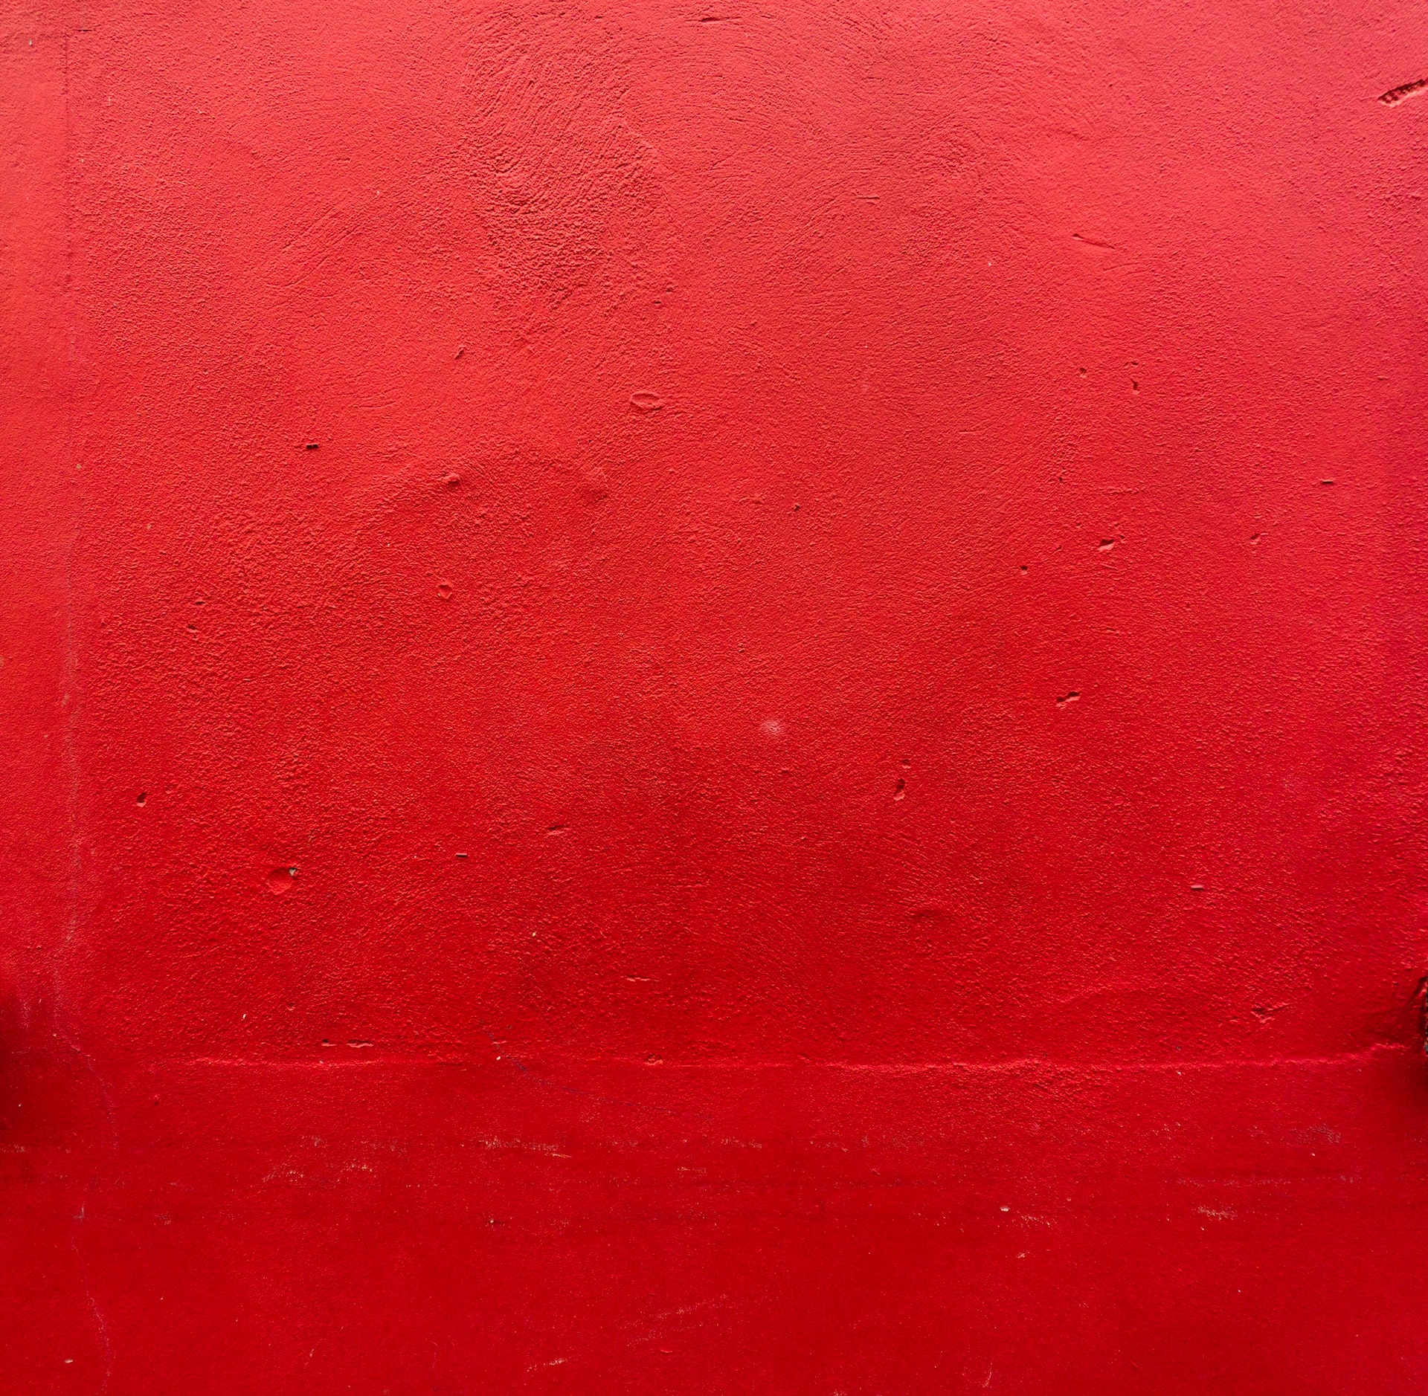
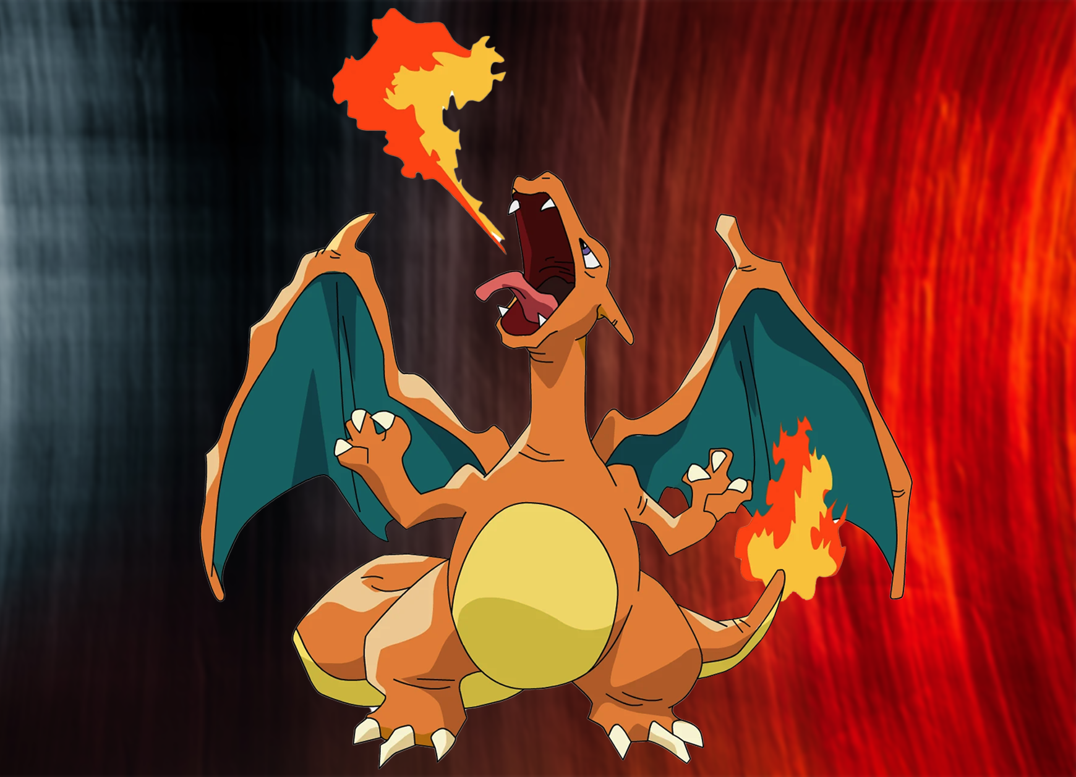
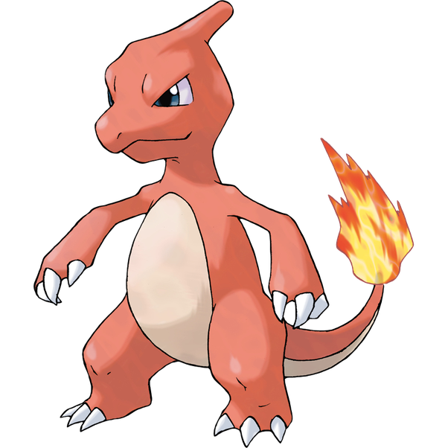



Charizard
LV.76
120
XP
Stage 2 Evolves from Charmeleon
1999 Pokémon Base 1st Edition Holo Charizard
Even with a Population over 120, the PSA 10 Charizard commands heavy $. Consider this, Michael Jordan’s PSA 10 fleer Rookie is valued over $650,000.00 meanwhile Charizard has almost a third the population while fetching half the price of MJ. You could say ‘Zard is the Jordan of Pokémon.
Flame Pokémon. Length: 5’ 7”, Weight: 200 lbs.
Pokémon Power: Energy burn As often as you may like during you turn (before your attack), you may turn all energy attached to Charizard into Fire Energy for the rest of the turn. This power can’t be used if Charizard is asleep, confused or paralyzed
Fire Spin
100
$350,000.00
Discard 3 Energy attached to Charizard
weakness
resistance
retreat cost
x2
-30
Spits fire that is hot enough to melt boulders. Known to unintentionally cause forest fries

Slide 6

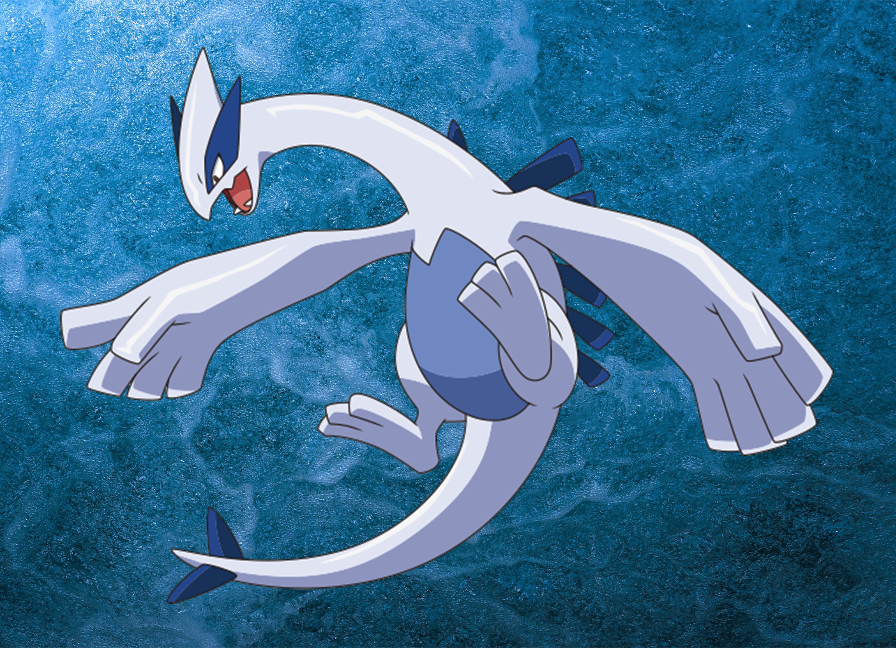

Lugia
130
XP
2000 Pokémon Neo Genesis 1st Edition Holo Lugia
With a Population of 42 PSA 10’s, Lugia has become a highly sought-after Grail. The drop off from PSA 10 to 9 is astounding, PSA 9’s sell around $8,000.00
Diving Pokémon. Length: 17’ 1”, Weight: 476.2 lbs.
Power Charger
Search your deck for a basic Energy card and attach it to this Pokémon. Then, shuffle your deck.
$129,000
Blasting Wind
110
weakness
resistance
retreat cost
x2
-20
Known as the Guardian of the Seas, Lugia is tremendously intelligent and is very gentle with the life around it, despite its colossal size

Slide 7


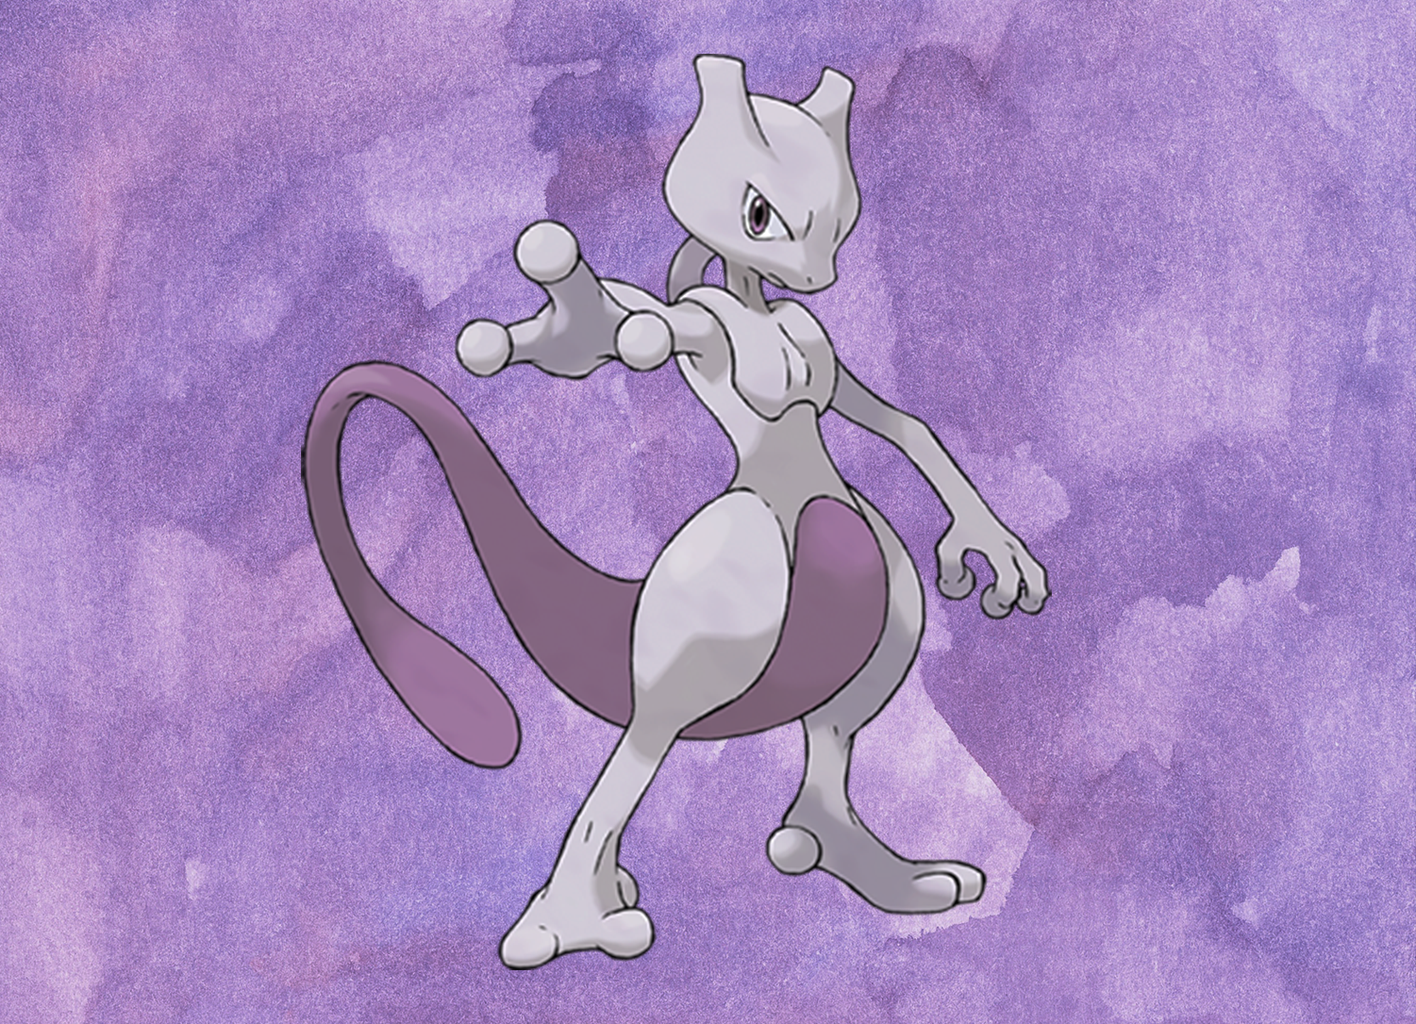
Mewtwo
XP
60
999 Pokémon Base 1st Edition Holo Mewtwo
Possibly the coolest Pokémon ever, and certainly the most powerful, Mewtwo joins the club after this staggering $22,655.00 sale back in November. With a PSA 10 population of 81, finding the English grail Mewtwo will be a tough task.
Genetic Pokémon. Length: 6’ 7”, Weight: 269 lbs.
Psychic Does 10 damage plus 10 more damage for each Energy card attached to Defending Pokemon
Psychic Energy card attached to Mewtwo in order to use this attack
$22,655.00
110
weakness
resistance
retreat cost
A scientist created this Pokémon after years of horrific genetic splicing and DNA engineering experiments.

Slide 8



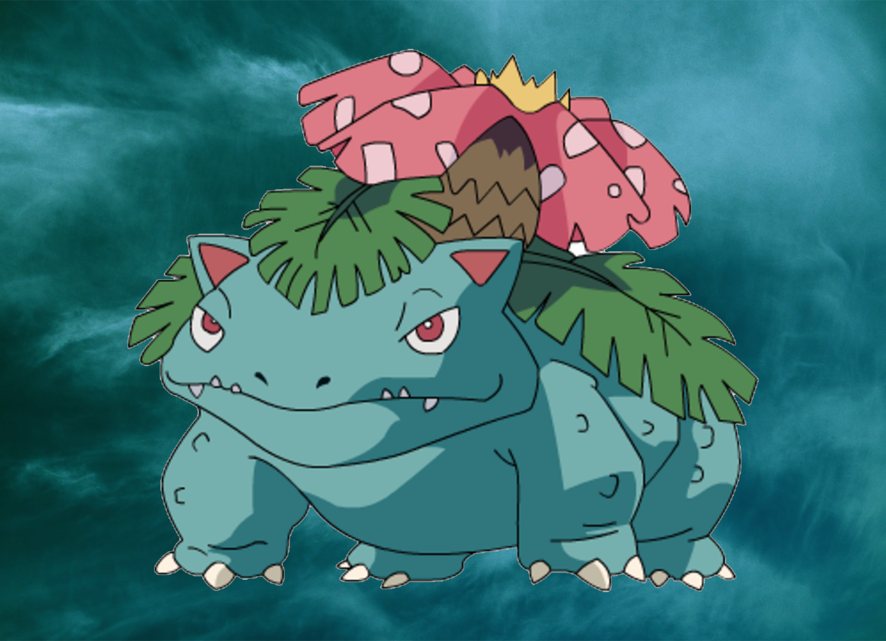
Venusaur
LV.76
180
XP
Stage 2 Evolves from Ivysaur
1999 Pokémon Base 1st Edition Holo Venusaur
The first member of the Big 3 to hit the list, Venusaur is undervalued currently. Due to timing and a market slowdown, Venusaur is the first of 7 Base 1st Edition cards on this list, yet he should be no lower than 5th. Even with 136 PSA 10 examples, this is one of the top English cards to obtain.
Flame Pokémon. Length: 5’ 7”, Weight: 200 lbs.
Pokémon Power: Energy Trans As often as you like during your turn (before your attack), you mat take energy attached to the Pokémon and attach it to a different one. This power can’t be used if Venusaur is or paralyzed
$22,615.00
Solarbeam
60
Discard 3 Energy attached to Charizard
weakness
resistance
retreat cost
x2
This plant blooms when it is absorbing solar energy. It stays on the moveto seek sunlught

Slide 9
Why Pokémon Cards Are So Expensive?
Pokémon trading card game is extremely popular
Pokémon cards are collector’s items. Many people view them as investments and are willing to pay a premium for rare cards
Manufacturing process for Pokémon cards is quite complex

Slide 10
Thank - You

Slide 11
Instructions for use
You must credit Slidechef in order to use this template
What you are allowed to do :
Modify this template
Use it for personal or commercial projects
What you are not allowed to do :
Offer Slidechef templates for download
Sublicense, sell or rent any Slidechef content
Distribute Slidechef content unless it has been authorized
Include Slidechef content in an online or offline file
Acquire the copyright of Slidechef content

Slide 12

Slide Chef

